Slide 1

What is a Naloxone Box?
And why should we consider implementing one?
Name of Presenter and Organization

Slide 2

Opioids in Our Community
*Insert statistics about overdoses happening in your community. This should paint the picture as to why you need to implement a naloxone box.*
Notes:
Before we dive into what a naloxone box is, let’s take a step back and look at the whole picture of what is happening in our community, specifically in regards to opioids.

Slide 3
Harm Reduction
“Harm reduction is a practical and transformative approach that incorporates community-driven public health strategies – including prevention, risk reduction, and health promotion – to empower people who use drugs (and their families) with the choice to live healthy, self-directed, and purpose-filled lives.” - SAMHSA
Notes:
There are many strategies that can be done to help reduce overdoses, but today we are going to focus on one of the harm reduction approaches to addressing this: distribution of naloxone (or Narcan) through the placement of naloxone boxes in the community.
First, let’s all get on the same page on what harm reduction is. “Harm reduction is a practical and transformative approach that incorporates community-driven public health strategies – including prevention, risk reduction, and health promotion – to empower people who use drugs (and their families) with the choice to live healthy, self-directed, and purpose-filled lives.”
What does this really mean? Realistically, no matter how much we do to prevent substance use, some people are still going to use drugs, whether by choice, disease or illness, or accident. And while we still will do everything in our power to prevent substance use, harm reduction is one strategy that aims to limit the harm caused by using drugs and ensures we are not leaving anyone behind in the community. For example, if a friend, child, or family member is misusing prescription opioids, we want them to be able to get the help they need – that their life does not have to ultimately end in an overdose. By doing this, we can meet people where they are at in their recovery journey. Harm reduction, and specifically naloxone boxes, allow us to do just that.

Slide 4
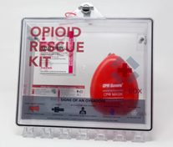
Naloxone Box: The Basics
Plastic box mounted on the wall
Contains:
  Naloxone nasal spray (NARCAN®)
  Gloves
  CPR breathing mask
  Instructions to administer medication
Similar to AED
AKA: NaloxBox, NaloxZONE Box
Notes:
Now, let’s dive into what a naloxone box is. As you can see in the picture, it is a plastic box that gets mounted to a wall.
The box typically contains naloxone nasal spray (or NARCAN), which is the medication that reverses the short-term effects of an opioid overdose. It also contains gloves and a CPR breathing mask since someone experiencing an overdose will likely need rescue breaths until help arrives. Lastly, the box also contains instructions on administering the medication and rescue breaths.
You can think of this box very similar to that of an AED – about the same size and the same general purpose: to save a life in an emergency.
Naloxone boxes do go by a few different names – some other common brand names include NaloxBox (pictured) and NaloxZONE box. With each brand likely comes some small differences in design or supplies included. It will be important to fully investigate what comes with each box before implementing one so we can know what supplies need to be purchased separately.

Slide 5
Two Uses of a Naloxone Box
Emergency Use
Emergent Use & Increase Naloxone Saturation
Only for emergencies
Often located at schools
For emergencies
Provides naloxone to individuals not actively experiencing an overdose
Often located throughout the community
Notes:
All naloxone boxes serve the purpose of providing lifesaving supplies. But there are two popular options for use of these boxes.
The first is for emergencies only. This box is placed in a location to be a resource should an emergency occur at that specific location. These boxes are often located at schools, but can be placed elsewhere too. They sometimes will have alarms on the box so when it is opened, surrounding staff can appropriately respond to the incident.
The second is for naloxone boxes is still to provide naloxone in emergencies, but also provides the community with a free supply of naloxone nasal spray. How does this work? These boxes are often stocked with multiple boxes of naloxone so a community member can come up to the naloxone box and take some medication. People choose to take naloxone for a variety of reasons but could include if they are concerned about their own or someone else’s substance use.

Slide 6
Location
Easy to access
Temperature regulated, naloxone must be kept between 68-77 degrees F
Place where people who use drugs commonly go
Emergency only boxes often place next to AED
Notes:
There are a couple of key considerations when it comes to the location of a naloxone box…
- A location that is easy to access is critical. If possible, place a box in a location that is available 24/7 and not behind locked doors.
The naloxone medication must be kept between 68-77 degrees so really all boxes should be placed indoors, especially being in Wisconsin.
Next, naloxone boxes are going to be most effective when placed where people who use drugs, or people who MAY use drugs, commonly go or congregate. Now this could be places like food pantries, warming shelters, etc. Or we could also think about our at-risk populations and where they go or get together.
For example, we do our best to prevent substance use among youth, but they may ultimately be peer pressured into trying something. By having naloxone available at school through a naloxone box, a child’s life could be saved should that experimentation turn out in a worst-case scenario.
Lastly, some agencies choose to place all emergency equipment in one central location for ease of access and recognition. This can be key in places where youth are present. Seeing a naloxone box next to an AED makes the association that the box is for emergencies only, is to be taken seriously, and not to play with.

Slide 7
Maintenance & Restocking
Insights:
Naloxone nasal spray expires after ~2 years.
Emergency only boxes will likely require less restocking.
Technology does exist to help notify staff when the box is opened.
Recommendations:
1-2 people dedicated to monitoring and restocking box
Lean on partners if worried about sustainability
Local health department
Recovery coaches / organizations
Wisconsin DHS
Notes:
As with implementing any new resource, it is important to think about the maintenance, restocking, and overall sustainability. So let’s talk about a few insights and recommendations that can help make a box a success.
INSIGHTS:
First off, the naloxone medication in the box has a shelf life of about 2 years. We hope that the naloxone wouldn’t need to get used, and if that’s the case, it will last quite some time.
Earlier we talked about the different purposes of naloxboxes. It is important to note that those emergency use only boxes will require less restocking because less naloxone will likely be taken out.
Technology does exist to help notify staff when the box is opened. Sometimes it is built directly into the box, and other times it can be added.
RECOMMENDATIONS:
Having a specific 1-2 people dedicated to monitoring and restocking the box can make sure the resource is always stocked and ready to go. Many other agencies have had success with this approach.
And lastly, there are local and statewide partners that can support us in the effort to implement a box.
Some health departments participate in Narcan Direct programs and could potentially supplement some of our Narcan or naloxone supply.
Perhaps partnering with a recovery coach or organization to help monitor the box if staff capacity is a concern. They could also potentially provide recovery resources to put inside or near the box.
Wisconsin Department of Health Services also has supplemental materials (posters, signs, infographics) available through Dose of Reality on their website.

Slide 8
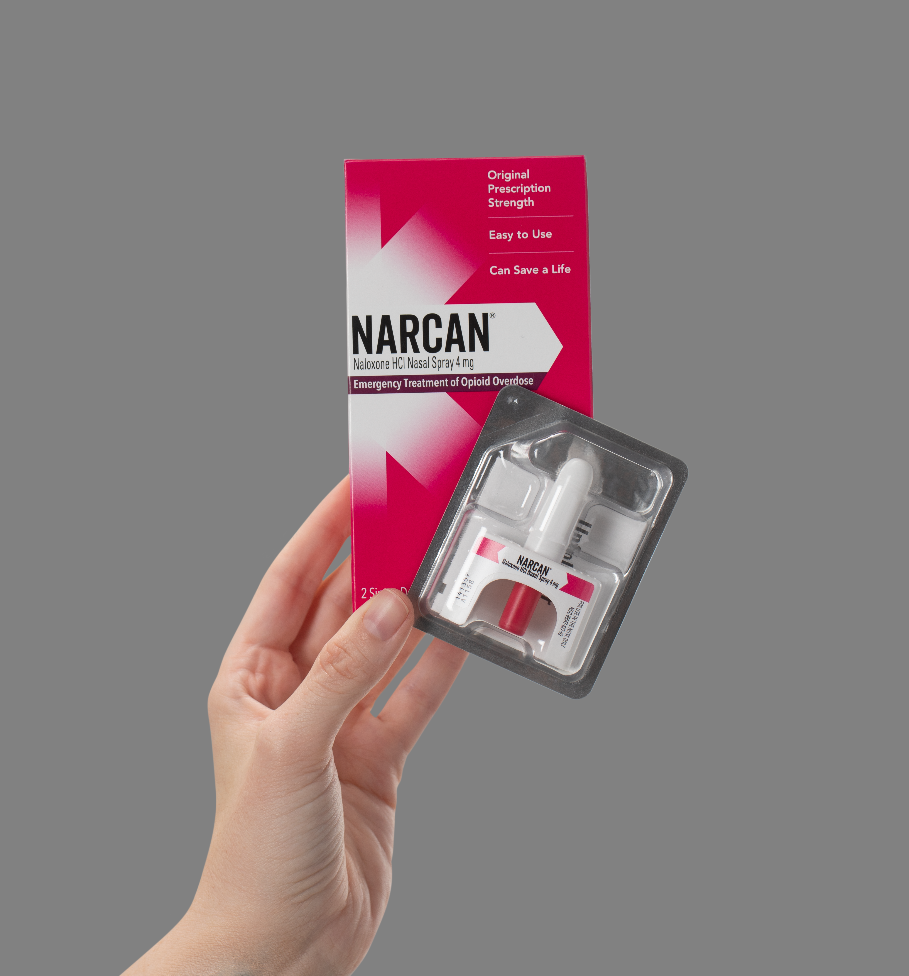
More About Naloxone
Opioid overdose reversal medication
Nasal spray is the most common form
  Easy to administer; training is available
For emergency use only
  No harm if person is not experiencing an opioid overdose
Available over the counter in Wisconsin
A.K.A. NARCAN® Nasal Spray
Image Courtesy of Emergent
Notes:
How many people are familiar with naloxone? Or as it’s also known as NARCAN? *depending on response, you can skim through this information or dive deeper*
For those that are unfamiliar, naloxone is the medication that can reverse the short-term effects of an opioid overdose. Simply put, the medication temporarily blocks the receptors in the brain from absorbing opioids. Many experiencing an overdose, stop breathing and this medication helps restore breathing until help arrives.
Naloxone does come in many forms, but it is most commonly available and distributed as nasal spray.
Naloxone only serves as an overdose reversal medication for emergencies – it can not be misused and will not cause harm if administered to anyone who is not experiencing an overdose.
And lastly, it is now available to anyone over the counter in Wisconsin. Making it very easy for use to access and supply to our community if desired.

Slide 9
Naloxone Administration Training
Covers:
How to recognize an overdose
The proper care to give when someone is experiencing an overdose
How to administer naloxone nasal spray
Does NOT replace the need for first responders & EMTs
Offered by:
County Health Departments
Department of Public Instruction
American Red Cross
Notes:
Naloxone nasal is incredibly easy to administer on yourself or someone else, however there is training available. By participating in a training, staff at a location with a naloxone box will feel more comfortable and confident in their ability to respond to an overdose emergency. In general, training covers how to recognize an overdose, the proper care to give when someone is experiencing an overdose, and then how to administer the naloxone nasal spray.
This training is widely available both in person and virtually. Some trainings have a cost associated with them, but most are free and about 30-45 minutes. It is important to note that if naloxone boxes are placed at a school, there are specific rules that need to be followed when it comes to staff getting trained. Checking with the Department of Public Instruction (DPI) would ensure proper steps are taken.
It is important to also note that this training does not replace the need for calling 911 and having first responders respond to an overdose. A life can be lost to overdose in a matter of seconds - before help even has a chance to get there. Naloxone and its administration training is simply helping to keep a person alive long enough for that person to get proper medical care should they choose to.

Slide 10
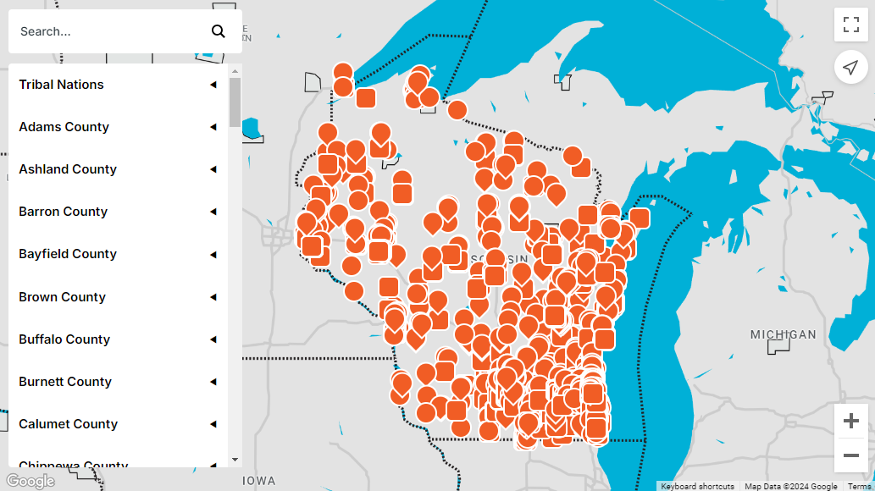
Who else has a naloxone box?
https://www.dhs.wisconsin.gov/opioids/safer-use.htm#naloxone
Notes:
At this point, you may be curious – who else really has these boxes?
This map is taken from the Wisconsin Department of Health Services showing all of the places in Wisconsin where naloxone is available for free or for purchase. While this looks like a lot of locations to the naked eye, we can also see that there are plenty of gaps and holes where naloxone is not available.
An overdose can happen anywhere, at anytime. So making this life-saving resource available in even our most rural communities is key to saving lives. By implementing a naloxone box, we can be part of that effort.
*Screenshot taken from DHS’ Dose of Reality on 8/12/2024 https://www.dhs.wisconsin.gov/opioids/safer-use.htm#naloxone

Slide 11
Thank You!
Insert Contact Information here
This was developed, in part, under grant number G39RH49497 from the Health Resources and Services Administration Rural Communities Opioid Response Program in partnership with Marshfield Clinic Health System.
NARCAN is a registered trademark of Emergent Operations Ireland Limited. The Harm Reduction Saves Lives Toolkit and Marshfield Clinic Health System are not affiliated with, sponsored by or endorsed by Emergent Operations
Ireland Limited or Emergent BioSolutions Inc.

Slide 12
References
Substance Abuse and Mental Health Services Administration (SAMHSA). (2023, April 24). Harm Reduction. https://www.samhsa.gov/find-help/harm-reduction

