Slide 1

What is Harm Reduction?
And why should we care about it?
Name of Presenter and Organization

Slide 2

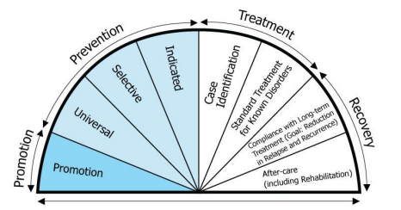
What is harm reduction?
“Harm reduction is a practical and transformative approach that incorporates community-driven public health strategies — including prevention, risk reduction, and health promotion — to empower people who use drugs (and their families) with the choice to live healthy, self-directed, and purpose-filled lives.” – SAMHSA
Continuum of Care
Continuum of Care – South Central NH Public Health Network (southcentralphn.org)
Notes:
We are going to start with discussing what harm reduction is and why it is important. According to SAMHSA’s (Substance Abuse and Mental Health Services Administration) the definition of harm reduction is “a practical and transformative approach that incorporates community-driven public health strategies — including prevention, risk reduction, and health promotion — to empower people who use drugs (and their families) with the choice to live healthy, self-directed, and purpose-filled lives.” "
Harm reduction is integrated throughout the continuum of care which is modeled by this half circle graphic. In promotion, harm reduction is safer practices. In prevention, harm reduction is overdose education, reversal medication, like naloxone nasal spray (NARCAN®), and clean needles to prevent death, injury, disease, and overdose. In treatment, harm reduction is referral to treatment and in recovery, it is intertwined with multiple pathways to recovery, like Medication Assisted Treatment (MAT) and Medications for Opioid Use Disorder (MOUD).

Slide 3


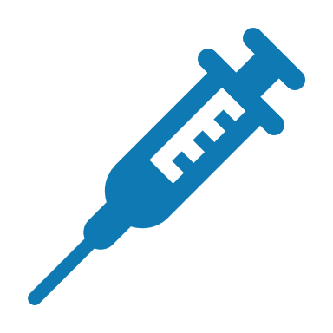
What does harm reduction look like?
Seatbelts, sunscreen, helmet, lifejackets, STI testing, condoms
Naloxone nasal spray (NARCAN®), fentanyl & xylazine test strips, clean syringe exchange programs, overdose prevention sites, sterile injection equipment
Notes:
Harm reduction is used in everyday life when we wear our seatbelts to avoid serious injury in the event of a car crash or applying sunscreen to minimize sunburns. Harm reduction specific to drug use looks like Naloxone nasal spray (NARCAN®) to reverse the short-term effects of an opioid overdose, fentanyl & xylazine test strips to detect the presence of hazardous additives in unregulated drugs which may lead to a person opting out of using those drugs, clean syringe exchange programs to provide sterile needles and to prevent the spread of infectious diseases, overdose prevention sites where trained staff can identify and respond to drug overdoses as well as connect people to support services, and lastly, sterile injection equipment to prevent HIV transmission.

Slide 4
What does harm reduction do?
Prevent injury, disease, death, and overdose
Bridge to treatment
Promotes healthy behaviors
Reduces stigma relating to substance use
Does not encourage drug use
Notes:
What does harm reduction do and how does it impact our communities? Harm reduction prevents injury, disease, death, and overdose. It saves lives by being accessible and user-friendly as we saw in the examples from the previous slide. Harm reduction is also a bridge to treatment. It is meeting people where they are at and supporting that person according to their individual needs. Harm reduction emphasizes autonomy. This is an important piece to harm reduction because each person’s path to recovery looks very different. Additionally, harm reduction also promotes healthy behaviors while reducing the stigma relating to substance use. Harm reduction does not encourage people to use drugs, because people who actively using drugs are going to use whether or not they have resources to do so safely. This is where harm reduction comes into play by providing tools to prevent unnecessary risks like HIV and hepatitis C and death.

Slide 5



Where should harm reduction services be located?
Community clinics, homeless shelters, food banks, health departments, churches, libraries, public transportation centers, urgent care centers, etc.
Notes:
Harm reduction services should be in places that are easily accessible such as clinics, food banks, and public transportation centers. *Could name harm reduction services specific to your community* It is important that these services are available to the public 24 hours of the day at a safe, non-judgmental location. A discrete location is helpful if a person wants to avoid being seen accessing harm reduction services. Keep in mind the significance of meeting people where they are at and minimizing barriers to access these services.

Slide 6
Why is harm reduction needed?
>102,000 drug overdose deaths in the U.S.
>1,400 opioid-related deaths in WI
Enter Community Specific Data
Notes:
The U.S. is in a substance use and overdose epidemic. There is increasing misuse of opioids and animal tranquilizers that is contributing to these statistics. More than 102,000 drug overdose deaths were recorded in the U.S from January 2023 to January 2024 and more than 1,400 opioid-related deaths were recorded in Wisconsin from 2020 to 2022. *Could pull in a statistic for local data here*

Slide 7
Why can’t we just promote cessation resources?
Cessation = stopping
It is important to respect the goal of the individual
Consider that there are multiple pathways to recovery
You can’t force someone to seek recovery
Notes:
The question might arise, why can’t we just promote cessation resources? Cessation is stopping or discontinuing, so it may not be someone’s goal to stop substance use at the time. Addiction is a disease and there are multiple pathways to recovery. Everyone's definition of recovery is different, and you can't force someone to seek recovery. Again, it comes back to the key phrase that is to meet people where they are at.

Slide 8
Harm reduction success stories
*Insert harm reduction success stories from your community here*

Slide 9
Thank You!
*insert contact information here*
This was developed, in part, under grant number G39RH49497 from the Health Resources and Services Administration Rural Communities Opioid Response Program in partnership with Marshfield Clinic Health System.

Slide 10
References
Ahmad FB, Cisewski JA, Rossen LM, Sutton P. Provisional drug overdose death counts. National Center for Health Statistics. 2024. https://cdc.gov/nchs/nvss/vsrr/drug-overdose-data.htm#citation
Coulson, M. & Hartman, M. (2022, February 16). What is Harm Reduction?. Johns Hopkins Bloomberg School of Public Health. https://publichealth.jhu.edu/2022/what-is-harm-reduction
Substance Abuse and Mental Health Services Administration (SAMHSA). (2023, April 24). Harm Reduction. https://www.samhsa.gov/find-help/harm-reduction
South Central New Hampshire Public Health Network. Continuum of Care. https://southcentralphn.org/continuum-of-care/
Wisconsin Department of Health Services. (2024, February 20). Dose of Reality: Opioid Data Summary Dashboard. https://www.dhs.wisconsin.gov/opioids/dashboards.htm

