Slide 1




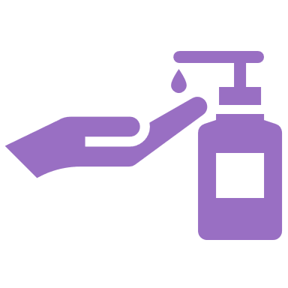


Harm Reduction is Everywhere
From life jackets and sunscreen to naloxone and fentanyl test strips, all forms of harm reduction have a purpose to prevent harm from happening.
Notes:
Suggested Caption: Harm reduction isn’t just about drug use; it can be applied to lots of things! In fact, you may be surprised by how much harm reduction naturally occurs in daily life. To learn more about what harm reduction looks like in Wisconsin, visit https://www.dhs.wisconsin.gov/aoda/harm-reduction.htm

