Slide 1
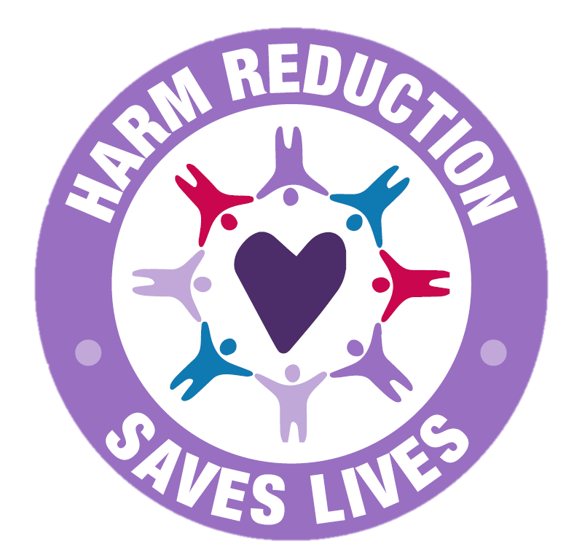
Notes:
Suggested Caption: Welcome to the Harm Reduction Saves Lives campaign. Over the next few weeks, we will post information about what harm reduction is, Naloxone and it’s use, hear from someone in recovery, and much more. Join us for the month of (Insert Month) as you learn how you can help break the stigma around harm reduction. You can start by learning more about harm reduction at https://www.samhsa.gov/find-help/harm-reduction

Slide 2
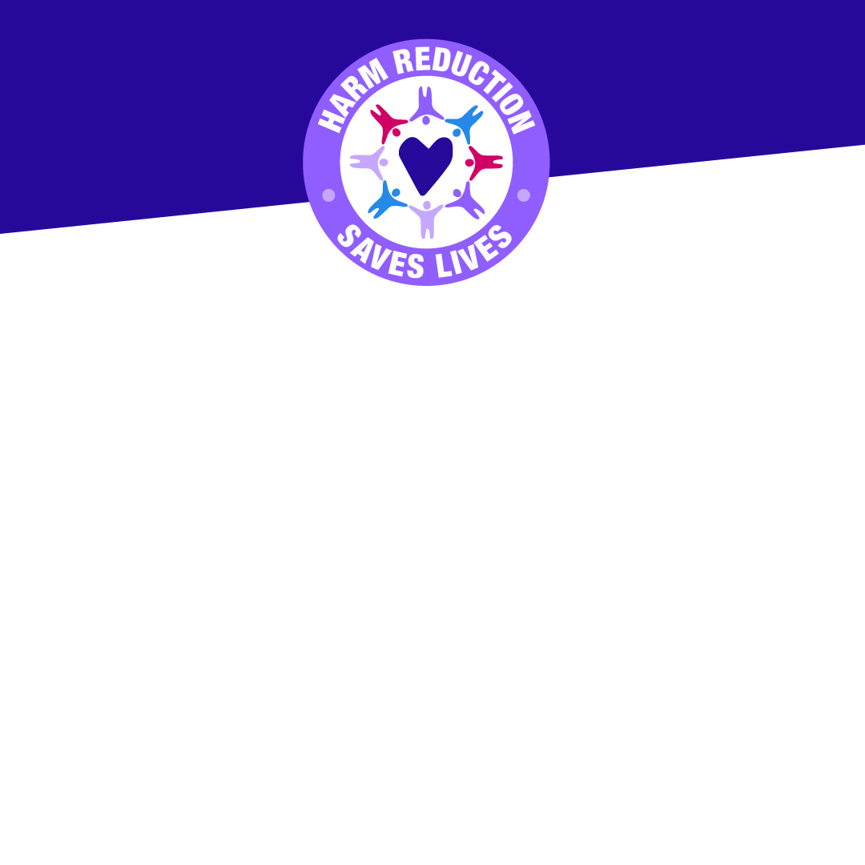
What is harm reduction?
According to SAMHSA, “Harm reduction is a practical and transformative approach that incorporates community-driven public health strategies — including prevention, risk reduction, and health promotion — to empower people who use drugs (and their families) with the choice to live healthy, self-directed, and purpose-filled lives.”
Notes:
Suggested Caption: Welcome to the Harm Reduction Saves Lives campaign. Over the next few weeks, we will post information about what harm reduction is, Naloxone and it’s use, hear from someone in recovery, and much more. Join us for the month of (Insert Month) as you learn how you can help break the stigma around harm reduction. You can start by learning more about harm reduction at https://www.samhsa.gov/find-help/harm-reduction

